Slide 1
Process Portfolio

Slide 2
Experimenting with Ideas
These are the beginning sketches for my digital college. To start this I first sketched what I wanted my eye to be for the background. Then I focused in on the iris and pupil and added the details that I wanted in my digital college. The details I wanted was to create my eye, using smaller images of my eye that had been manipulated in size and color. After my first two initial sketches, I went on to draw my full size eye to get an idea of what it would look like.

Slide 3
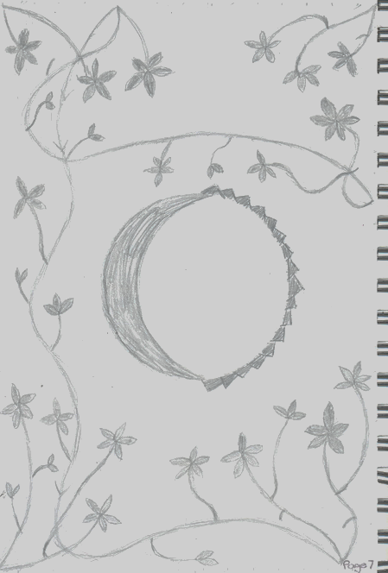
Experimenting with Ideas
For my block print ideas, I wanted to do something with nature. To do this I wanted to incorporate the art nouveau style. In order to do this I used floral and vines to add to the nature idea.
I wanted something in the center, but I did not want to have a figure in the center so instead I kept the circle, and I added a crescent moon and sun.

Slide 4
Experimenting with Ideas
I used this photo that I took while I was at beach on vacation. When I took it I did not think that I was going to use it for an artwork, when I was thinking about ideas to do my drypoint piece, I thought about nature and how I could incorporate nature into my piece. I then found the picture I took and I then did a quick sketch of the photo.

Slide 5
Experimenting with Ideas/Media
One thing that I like to do is travel and I wanted this to be shown in my piece. In order to make this, I found a little styrofoam bird and I took a map and began cutting out little feathers to place onto my bird using little pins. I like this way to show travel because it show travel since birds typically fly south during the winter. The box I want to represent the a torso and I want to find a porcelain doll head that I can place on top so it would be like a body. Then with the bird inside the box it would represent a heart.

Slide 6
Experimenting with Media
This is the beginning of the bird for my mixed media piece that was in my last slide. I decided to start at the tail of the bird with longer feathers because that would make it look more like a bird. This process was tedious because I had to cut small feathers then use small pins to place all the feathers. This process of cutting all the small feathers with an exacto-knife and then placing them with the pin took a long time to cover the entire bird

Slide 7
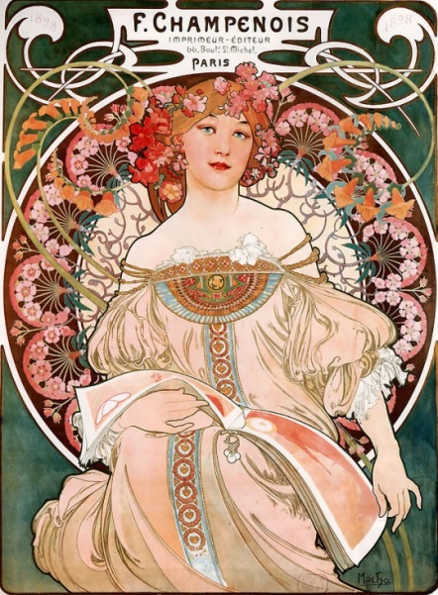
Artist Inspiration- Self Portrait
For my self-portrait I wanted have art nouveau be the style that it was in. While researching art nouveau and the various artists, I remember learning about Mucha my sophomore year. One of the pieces he did that was my favorite was F.Champenois. This piece is what I used for my artist inspiration to make my self portrait.
To better capture Mucha’s artwork, I want to have the colors be as close as possible, the flowing organic lines, and the floral background.
Mucha, Alphonse M. F Champenois Imprimeur Editeur. 1897. Alphonse Maria Mucha The Complete Works. Web.

Slide 8
Self-Portrait Work in Progress
For my self-portrait I used Mucha as my artist inspiration. In order to connect my artwork back to Much’s F.Champenois, I used that as my background image and then replaced the girl that was in there, for myself. The process for painting this was difficult when it came to the background because there was a lot going on, and I had to have clean and opaque colors.

Slide 9
Experimenting with Media
For this piece I wanted to create a tree out of garbage. I decided on this because when you go outside there is normally garbage that is lying around outside. With this piece I wanted to show that with making an organic item like a tree, but instead of it being natural, it is made of the garbage that it outside on the ground. In this first image is the first idea I had to construct the tree out of entirely soda cans. This idea however, did not work when I was trying to make the tree. Instead, I found clear glass bottle. To make the branches,

Slide 10
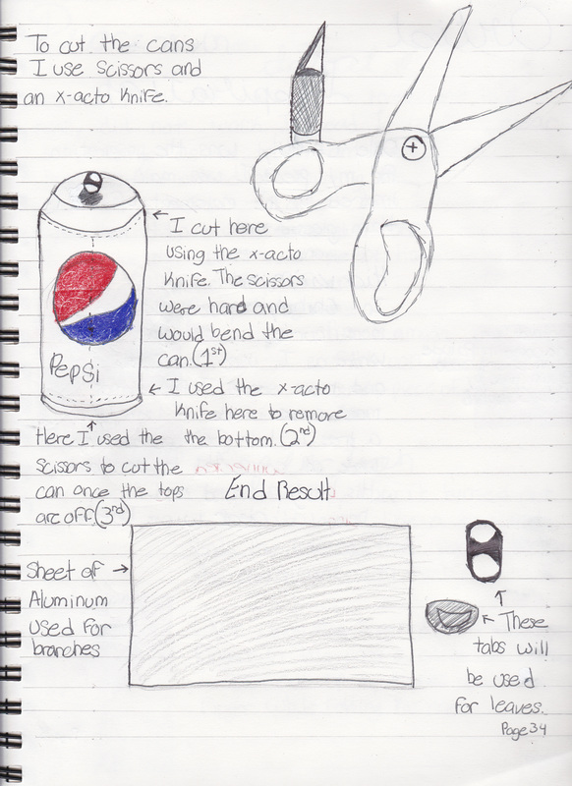
Experimenting with Media Continued
The second image continues the process of making the glass bottle into the tree using soda cans. I first took the soda can and used an x-acto knife to make a small cut, then with the scissors, I cut around the top and bottom to get a sheet of aluminum. Then I cut smaller strips of the aluminum using the scissors. With these smaller strips I folded them in half and first using super glue, I placed them onto the opening and neck of the bottle. However, this was not working because they kept falling off, so to make them stay I used hot glue which proved to work better for the strips to stay. To make the leafs I used the tabs, and placed them onto the strip with hot glue.

Slide 11
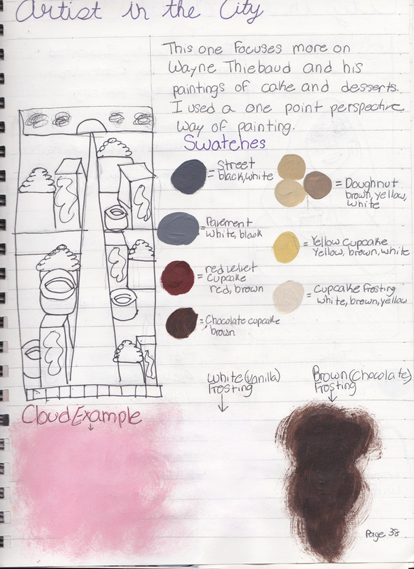
Developing Ideas
This page is from a tryptic. I wanted to use my passion for baking in this art work. To do so, I used the one point perspective. But, instead of having there be buildings, I used a series of baked goods that included; cupcakes and doughnuts. The hardest part about this was making the rounded shaped doughnuts.
The swatches for the color of paint that I used for creating this piece is also on here. I wanted to use bright colors because I wanted it to somewhat resemble popart. My favorite baked good to paint on this piece was the red velvet cupcakes since they are my favorite to make.

