Slide 1
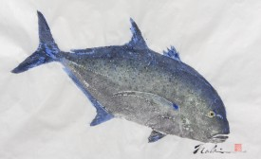
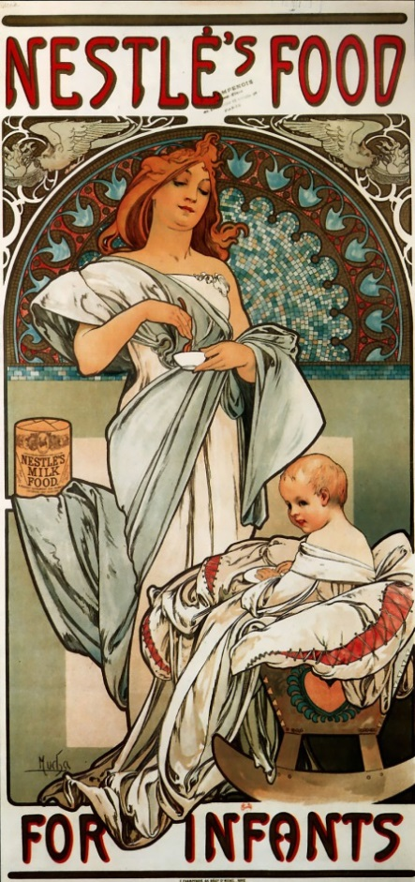
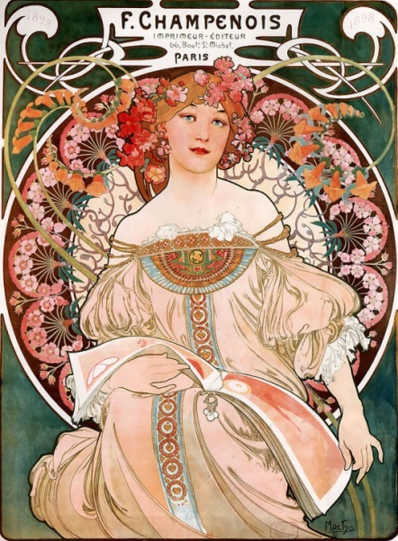
Comparative Study
Mucha, Alphonse M. Nestles Food For Infants. 1897. Alphonse Maria Mucha the Complete Works. Web.
Naoki. Blue Fin. N.d. Gyotaku. Kaneohe, Hawaii.
Jackie Hammond
Mucha, Alphonse M. F Champenois Imprimeur Editeur. 1897. Alphonse Maria Mucha The Complete Works. Web.
This will compare the usage of the elements of art and principles of design of Mucha and Naoki. There is the common theme difference of subjects that are being used and medium, but both artists have elements and principles used that are the same.

Slide 2
Introduction
For the Comparative study, I chose to focus on the artist Alphonse Mucha and his artworks “F Champenois Imprimeur Editeur” and “The Nestle’s Baby Food”. I will be comparing and contrasting both of those works against Naoki and his work “ Blue Fin”. The main difference between these two artists is that Mucha is an Art Nouveau artist while Naoki is an artist who specializes in gyotaku. The traditional Japanese fish printing method.
Mucha, Alphonse M. F Champenois Imprimeur Editeur. 1897. Alphonse Maria Mucha The Complete Works. Web.
Mucha, Alphonse M. Nestles Food For Infants. 1897. Alphonse Maria Mucha the Complete Works. Web.
Naoki. Blue Fin. N.d. Gyotaku. Kaneohe, Hawaii.

Slide 3
Alphonse Mucha
Alphonse Mucha is a classically known artist for his work in the Art Nouveau movement. Much’s work frequently features beautiful, young women, Neoclassical-looking robes, floral detailing, and pale pastel colors but also vibrant colors. Which was very popular in the Art Nouveau style.
Mucha used these features as a way for advertisements and posters. Mucha more frequently used them in his paintings but the influence can be seen in the carpets, illustration, and wallpapers that Mucha created.
His culture influenced his work in the sense that he wanted his artworks to be a product of himself and Czech art. Traditionally Czech art is glass and crystal. Mucha has made his own artwork using glass and the style that is present in his glass work appears in his paintings as well.
Mucha, Alphonse M. F Champenois Imprimeur Editeur. 1897. Alphonse Maria Mucha The Complete Works. Web.

Slide 4
Art Nouveau
Art Nouveau was most popular during the last 19th century and the early 20th century. During the 19th and 20th century there was a very high demand in decorative arts for the home. These decorative arts often included designs that were inspired from rose windows or Tiffany glass. Art Nouveau artists used rose windows and Tiffany for the floral details that often included in the art works.
The Art Nouveau style was also used in designs of houses, jewelry, and furniture. This style of Art Nouveau often did not include the floral details that are popular in Mucha’s work. Instead the designs that the architects used were similar in comparison to Mucha’s works, in the sense that there was typically a use of organic lines and shapes that can be see in both Nestle’s Food For Infants and F. Champenois. The furniture, jewelry, and houses designs that were used reflect Art Nouveau and can still be considered Art Nouveau because of how the designer and architects used the elements and principles that Art Nouveau painters were known for.

Slide 5
Naoki
Naoki is a artist that is based in Hawaii. He is known for his work in gyotaku. This is a traditional Japanese artwork that uses freshly caught fish to make a print off of the fish on shoji paper.
Naoki uses colors in his works but, there are often cool colors. Naoki does this because fish are more cooler colors compared to warmer colors. The colors that are normally used are more muted in contrast with the white shoji paper in the background.
In Hawaii, there is a large population of Japanese. These influences of the Japanese culture are what have influenced Naoki to produce his fish print. Naoki uses the traditional way of fish printing to produce all his artworks.
Naoki. Blue Fin. N.d. Gyotaku. Kaneohe, Hawaii.

Slide 6
F Champenois Imprimeur Editeur
In this painting Mucha uses organic line shape, pastel color, flowing hair, repetition in the background and floral work throughout this piece. The organic lines are used in a way that there are no harsh lines within the painting. The flowing hair that Mucha creates in this piece also uses the organic lines. Repetition in the piece creates a form of unity throughout the piece. There is harmony between the flowers and organic lines in the background. The emphasis of this work is on the woman in the center. The pastel colors used in the dress contrast the darker colors that are in the background.
There is also movement within the piece. The movement occurs with the women drawing in your eyes in first. Then they travel in the background where the floral pattern in the emphasis of the background. The colors used here are not as pastel as the colors on the dress. They are brighter in the background to add contrast to the piece between the women and background. The green in the background changes value as it descends down the piece. This change in color value also add movement to the piece.
The Czech culture of glass art can be seen in the background of the painting as the circle of floral can resemble glass artworks.
Mucha, Alphonse M. F Champenois Imprimeur Editeur. 1897. Alphonse Maria Mucha The Complete Works. Web.

Slide 7
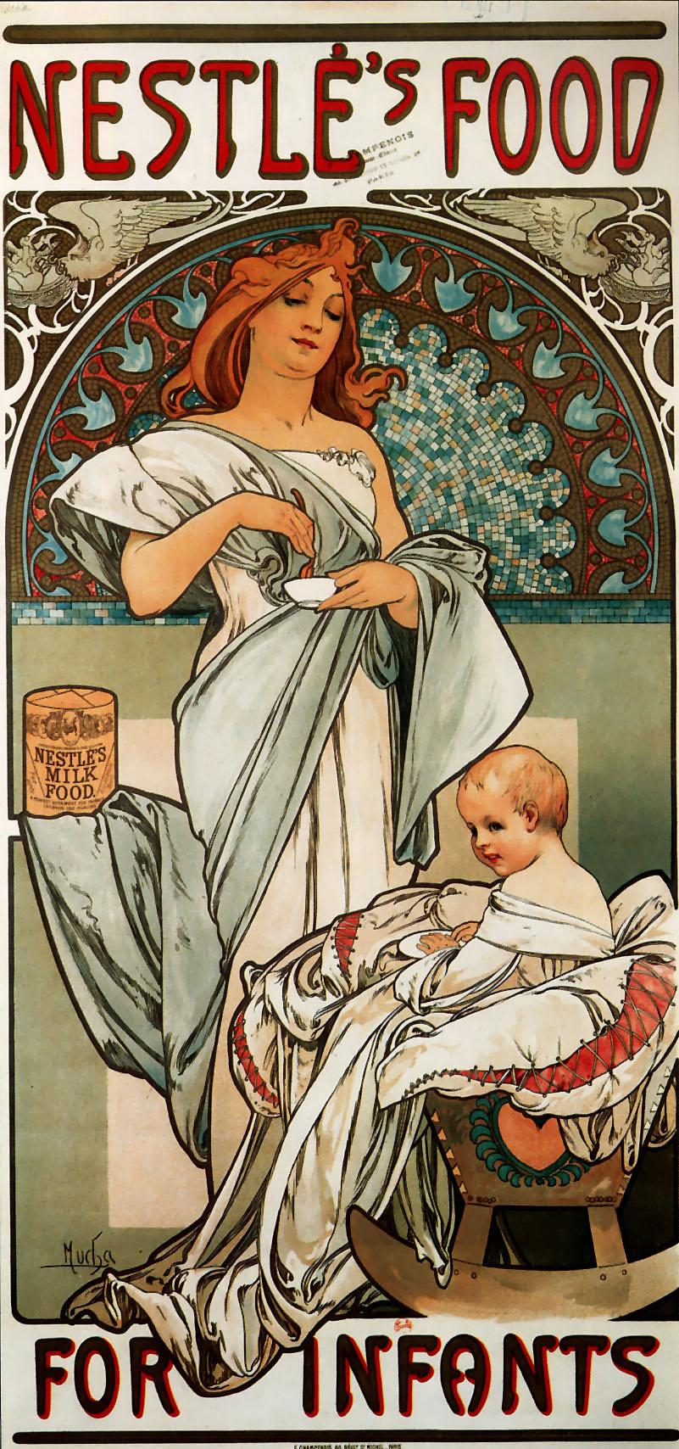
Nestles Food For Infants
This painting is one of Mucha’s paintings that is an advertisement. For this particular advertisement Mucha is advertising “Nestle’s food for infants”.
Mucha uses the organic lines in this piece. It is most noticeable in the background of the piece. But it creates movement within the piece in the clothing that moves you eyes around the piece. The colors that are used in this piece are cooler toned. This adds contrast between the foreground being warmer tones and background being cooler tones. Like many of Mucha’s painting there is soft blending in the face and no where else on the painting. The emphasis of this piece is placed on the face as it is what draws the eyes attention because it is blended. Compared to other pieces of Mucha’s artwork this one does not include floral work. This artwork gives off a motherly feeling and it can be represented by the mother and the child. But also the bird feeding the little chicks.
Czech glass art influence is present in the background of the piece. The painted tiles look as is they are a mosaic of stained glass.
Mucha, Alphonse M. Nestles Food For Infants. 1897. Alphonse Maria Mucha the Complete Works. Web.

Slide 8
Traditional Japanese Gyotaku
Gyotaku is the traditional Japanese fish printing process. The process can be used using blank or colored ink. Naoki uses colored ink as a way to show the color of the fish that is being pressed. Much like the traditional prints, details can be seen or even be expressed as a different color depending on the ink will take the surface of what it is being printed on. On traditional gyotaku can be done on leafs, clothes, paper, or wood. Naoki prefers to do his on shoji paper which is a translucent paper that is typically used as a door or room divider over a frame of wood. Using the shoji paper to print on allows the fish to be the emphasis of the artwork.
The fish in both Naoki’s work and in traditional gyotaku is the emphasis of the work. Since there is no other object there to have the emphasis or create movement in the work besides in the fish; it creates a strong contrast of colors between the foreground and background.

Slide 9
Mucha vs Naoki
Since Mucha is a classical artist, there is much more use of elements of art and the principle of design. One of these is the use of line within his works. Mucha will use the line as an outline for his subjects and floral work in the background. This use of line is influenced by the Czech glass art that influenced Mucha’s work in the elements and principles that he used.
Naoki is more of a modern artist though he uses the old Japanese tradition of gyotaku. Naoki uses emphasis and contrast in his artworks. This is found in Japanese gyotaku as the fish is typically the only thing printed on the paper and is then the emphasis. As the fish being the emphasis, there is high contrast between the foreground and background because there is nothing in the background except a blank piece of paper or what the fish is printed on.
Naoki. Blue Fin. N.d. Gyotaku. Kaneohe, Hawaii.
Mucha, Alphonse M. F Champenois Imprimeur Editeur. 1897. Alphonse Maria Mucha The Complete Works. Web.

Slide 10
Comparing Both of Mucha’s work against one another
The first major between the two is that there is much more floral work in F. Champenois than there is in “Nestle’s food for infants”. This is because F. Champenois is a painting compared to “Nestle’s food for infants” which is an advertisment for baby food. Within F. Champenois it is more classically Art Nouveau because of the floral detailing that is present.
“Nestle’s food for infants” creates a motherly feeling in the artwork because of the mother going to feed her child, but also the birds that are feeding their young. In comparison F. Champenois creates a sexy feeling.
In both “Nestle’s food for infants” and F. Champenois, the faces are smoothly blended creating the emphasis of the piece there and having contrast between the foreground and background.
Mucha, Alphonse M. F Champenois Imprimeur Editeur. 1897. Alphonse Maria Mucha The Complete Works. Web.
Mucha, Alphonse M. Nestles Food For Infants. 1897. Alphonse Maria Mucha the Complete Works. Web.

Slide 11
Mucha’s Cultural Inspiration
For Mucha his inspiration came from Czech glass. Mucha wanted to make his art himself and Czech art. Czech art is mainly done in the form of glass. There is mosaic like qualities to the work and that can be seen within all of Mucha’s work by the form of a circle that can resemble mosaics. Within the circles there are elements such as bright color that contrast the emphasis of the piece. Also like Czech glass there is unity within the piece. Mucha frequently uses unity throughout his pieces to convey the soft patterns that are within his works. Line work is also very present in Czech glass and that influence can be easily seen within Mucha’s work. His use of organic line work is in all of his paintings and has become a defining feature in his works as well as floral detailing.
Mucha, Alphonse M. F Champenois Imprimeur Editeur. 1897. Alphonse Maria Mucha The Complete Works. Web.
Mucha, Alphonse M. Nestles Food For Infants. 1897. Alphonse Maria Mucha the Complete Works. Web.

Slide 12
Blue fin compared to “Nestle’s food for infants”
Naoki. Blue Fin. N.d. Gyotaku. Kaneohe, Hawaii.
The first major difference between these two works is the different cultural influences for these pieces. Mucha uses Czech glass art as his influence. This is seen within the background semicircle that has the appearance of a mosaic. “Blue Fin” on the other hand influences come from traditional Japanese fish prints.
Both of these pieces utilize cooler toned colors that add to the contrast to the foreground and background allowing the audience to focus on the form that is within the emphasis of the piece. For “Blue Fin” the emphasis is the fish while in “Nestle’s food for infants” the emphasis the women and child.
Mucha, Alphonse M. Nestles Food For Infants. 1897. Alphonse Maria Mucha the Complete Works. Web.

Slide 13
“Blue Fin” Compared to “F. Champenois”
In this comparison of both artworks is similar to the comparison of Blue Fin and Nestle’s food for infants. The cultural inspiration is from two different cultures. The first is the traditional Japanese fish printing, gyotaku. Naoki uses the traditional method for the process and it produces the imprint of the fish using colorful ink. In Mucha’s F.Champenois, he uses Czech glass art as the inspiration. This is seen in the background of the piece where the circle looks like a glass window.
Blue Fin also uses cooler toned colors where the primary color is blue and F. Champenois uses warmer more pastel colors. The use of colors in both pieces helps the contrast between the foreground and background. Another comparison that can be made is that there is only blend in the face of F. Champenois and there is no blending in Blue Fin but instead a change is the blue color value.
Naoki. Blue Fin. N.d. Gyotaku. Kaneohe, Hawaii.
Mucha, Alphonse M. F Champenois Imprimeur Editeur. 1897. Alphonse Maria Mucha The Complete Works. Web.

Slide 14
“Blue Fin”, “F. Champenois”, and “Nestles food for infants”
Naoki. Blue Fin. N.d. Gyotaku. Kaneohe, Hawaii.
All of these artworks have an emphasis on one subject. For Mucha’s “F. Champenois” and “Nestle’s food for infants” it is the women and child that draws the eye in first. This is common in Mucha’s work as it generally has a women painted in it. Like Mucha, Naoki in “Blue Fin” the eye is drawn to the subject of the painting. His subjects are fish instead of people.
The color between the three are different as well. There use of almost all warm pastel colors in “F. Champenois”. When “Blue Fin” and “Nestle’s food for infants” is looked at it can be seen that there is primarily use of cooler colors such as blue. However there is use of warm colors in “Nestle’s food for infants” in the faces and hair of the woman and child.
Another point that “F. Champenois” and “Nestle’s food for infants” have in common is that is little to no blending which is also seen in “Blue Fin”. But there is blending within the faces of both of Mucha’s. That is very popular in Art Nouveau pieces and blending in gyotaku is hardly ever seen. There is color value that changes on the fish, but it is not done using a brush.
Mucha, Alphonse M. F Champenois Imprimeur Editeur. 1897. Alphonse Maria Mucha The Complete Works. Web.
Mucha, Alphonse M. Nestles Food For Infants. 1897. Alphonse Maria Mucha the Complete Works. Web.

Slide 15
The elements of art and principles of design that both artists use
After researching and comparing and contrasting Mucha and Naoki through F. Champenois, Nestle’s food for infants, and Blue Fin. It is clear that being from different cultures and time periods there is still the use of some of the same elements of art and principles of design.
These include the emphasis of the painting. In all three paintings there is always a subject that is present in the foreground of the artworks. The subject of the artwork was different, but the emphasis put on the subject was the same. They always had a contrast to differentiate the subject from the background so it did not blend in. The contrast can be in the pattern and unity of Mucha’s background by using floral work or a mosaic like pattern allowing the eye to move throughout the work. Or in Naoki’s contrast by only having the printed fish on the paper, making the eye even more drawn to the fish. Both artist use this to their advantage to draw the eye to where they want then use movement to move the audience's eyes around the piece.
Naoki. Blue Fin. N.d. Gyotaku. Kaneohe, Hawaii.
Mucha, Alphonse M. Nestles Food For Infants. 1897. Alphonse Maria Mucha the Complete Works. Web.

Slide 16
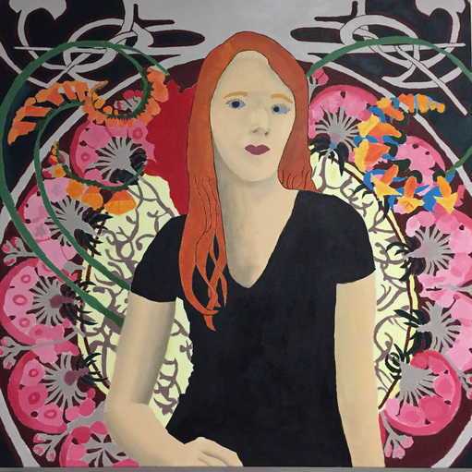
Self Portrait
After taking art history my sophomore year and learning about all the different artists and the styles of the art movement, I knew that I wanted to used Art Nouveau as my movement but I still had not decided which artist. I choose Mucha and his F.Champenois in particular because I liked how there was a contrast between the background and how the colors within the background were contrasted. There is also a clear background and foreground. While creating my self portrait, I tried to incorporate and use the techniques that Mucha often uses.

Slide 17
Self Portrait vs F.Champenois
Blended in the arms
Less elaborate clothing
While making this piece I tried to incorporate the techniques that Mucha often uses. To do so I followed how in the hair it is all one tone and towards the ends of the hair it has organic shape and is outlined
Only blended in the face
Use of words at the top of the painting
Use of organic lines and shape.
Floral detail that resembles rose windows in the background
Mucha, Alphonse M. F Champenois Imprimeur Editeur. 1897. Alphonse Maria Mucha The Complete Works. Web.

Slide 18
Self Portrait vs Nestles Food for Infants
In both artworks, the movement of Art Nouveau is present through the use of having only the face being blended compared to the rest of the body, organic lines, and outlining of the hair.
In Nestles Food for Infants, it is used for an advertisement compared to my self portrait where it is not an advertisement. There is also no use of floral work but in my self portrait I used floral detailing in the background. I also Blended in part other than my face.
In both there is the emphasis on the figures being in the forefront.
Mucha, Alphonse M. Nestles Food For Infants. 1897. Alphonse Maria Mucha the Complete Works. Web.

Slide 19
Self Portrait vs Naoki
The major difference between the two is that the main subject are different. There is also less use of color in Naoki’s piece, whereas I use a variety of colors within my piece. The technique that is used is also different in how the pieces were made. In my piece it is a painting, but in Naoki’s, it is a fish print that is made with ink. There is a feature of nature in both because in my piece I use floral as my nature element, and in Naoki’s, the nature element is that the subject is a fish. The similarities are that there is a use of color that is in both. There is also a use of blending that can be seen in the gradient in Naoki’s and in mine I used blending in the arm and face.
Naoki. Blue Fin. N.d. Gyotaku. Kaneohe, Hawaii

Slide 20
Self Portrait as a whole
For my self portrait, I like how the background turned out with the colors, flowing organic lines, and the hair. When comparing my painting to Mucha’s, I think I could have done better blending in the face. If my blending was better I think that it would better compare and be similar to Mucha’s.
Even though it is not blended like Mucha’s, my self portrait is similar because of the techniques that Mucha used and how I incorporated and used his techniques. There is unity and repetation that is in both mine and Mucha’s.
As a whole, I think that my piece is similar to Mucha’s F.Champenois. One thing that I think that I could have done differently was try and improve my blending in the face and not blend so much in the arm since only the face is blended in Mucha’s.

